Slide 1


License Generator & PC IDs based verification
Shmouel Hai ILLOUZ
Yossef HALEVI

Slide 2

Digital piracy: Hidden theft. Anyone could be involved.

Slide 3

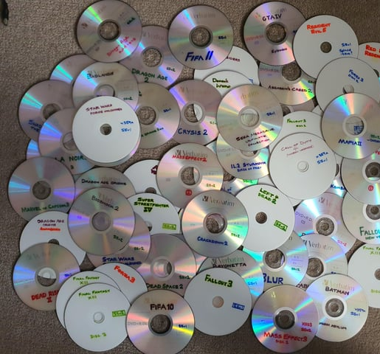




Slide 4

Be honest, no shame.

Slide 5

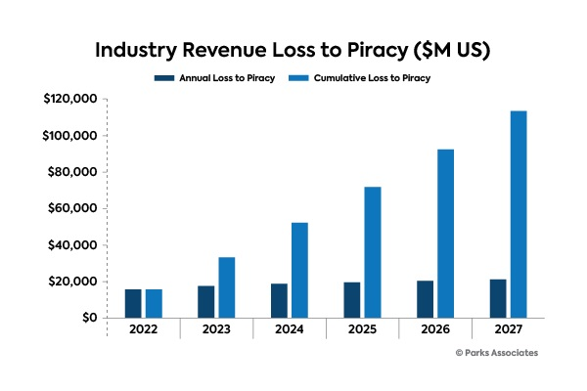

Slide 6
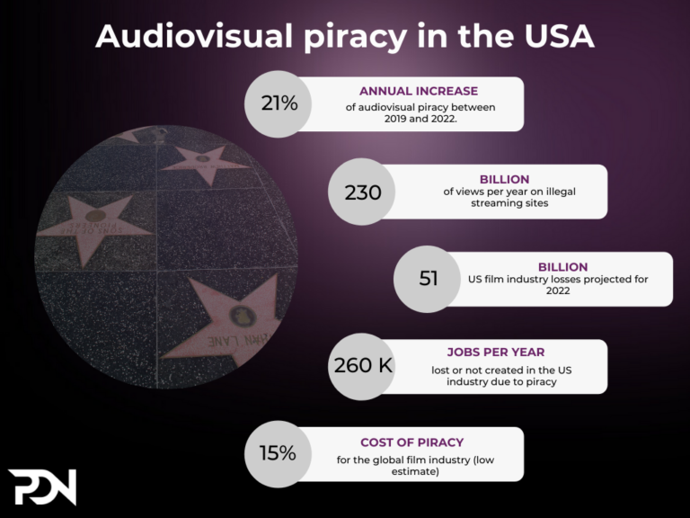

Slide 7

Share with friends

Slide 8
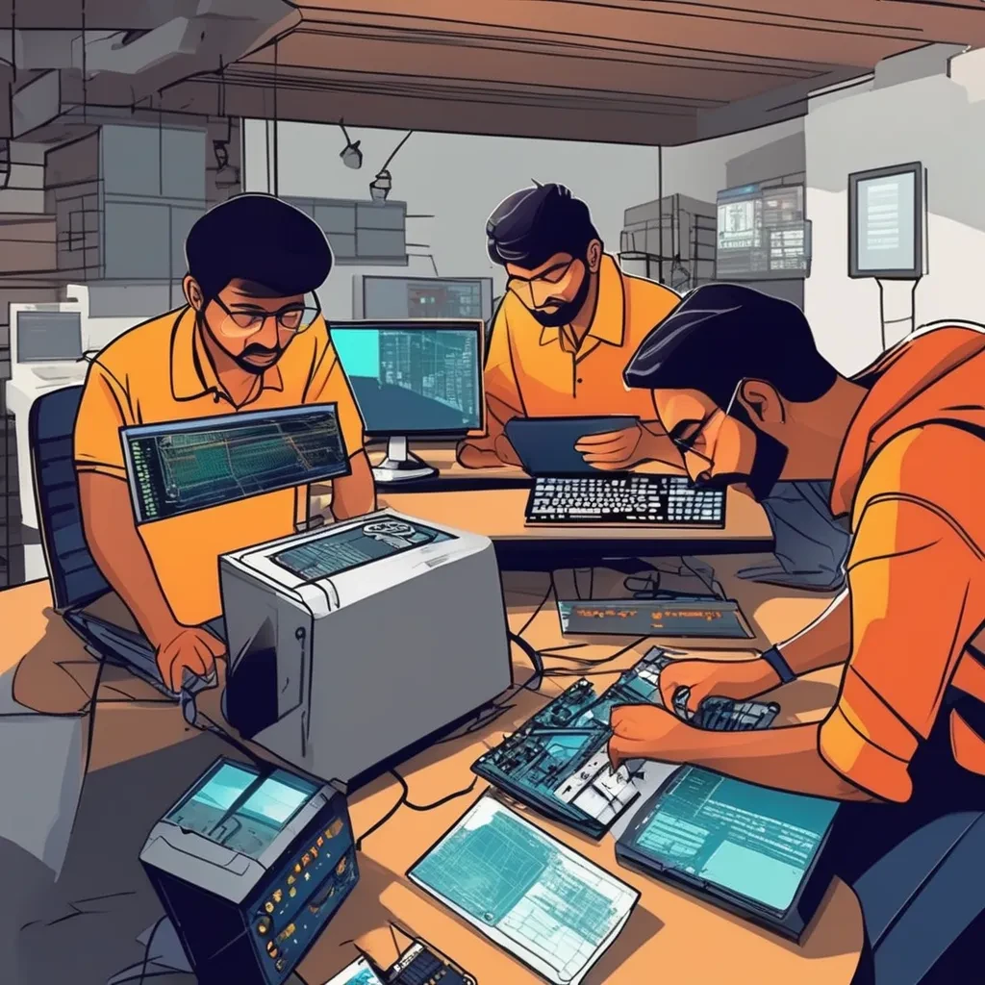
Reverse engineering

Slide 9
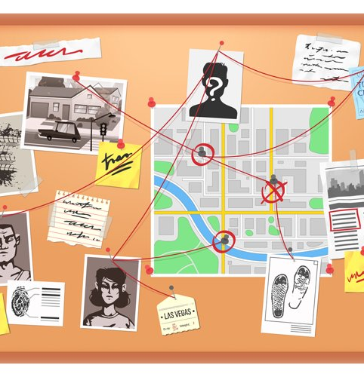


Slide 10


Slide 11




Unique identifier for each software
unique software for each client
obfuscation of the code

Slide 12


Slide 13

License Generator
PC IDs
Key
Generation Time
RSA Digital Signature

Slide 14
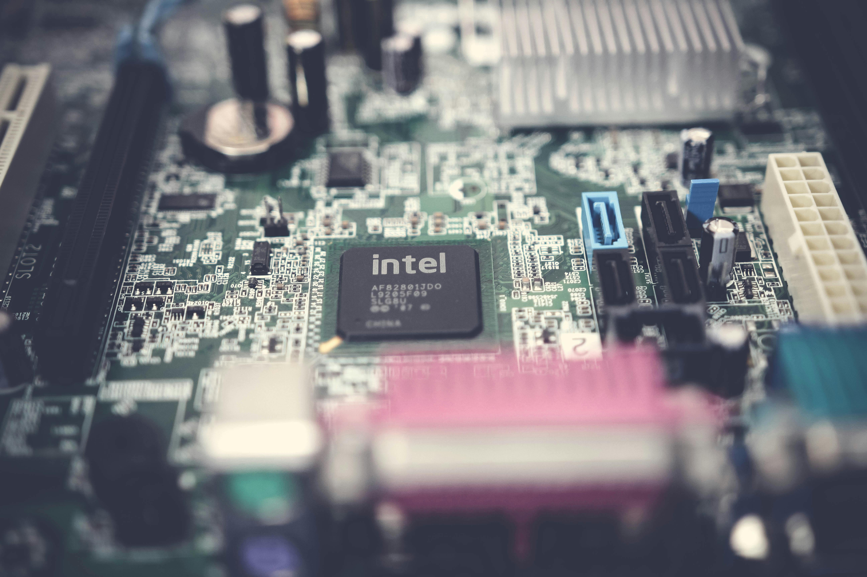
PC IDS
Uniqueness
Stability
Difficulty of modification
Resistance to spoofing
MAC Address
Disk UUID
Volume Serial Number
Processor ID
Motherboard ID

Slide 15
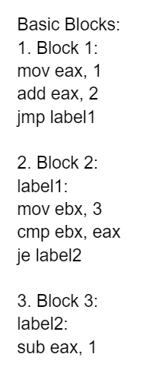
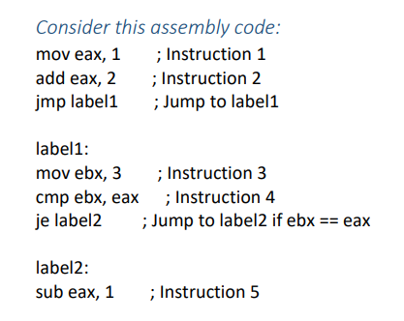

Slide 16
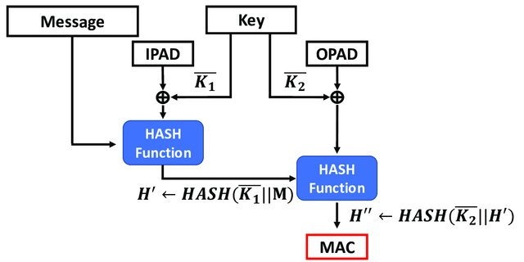

Slide 17
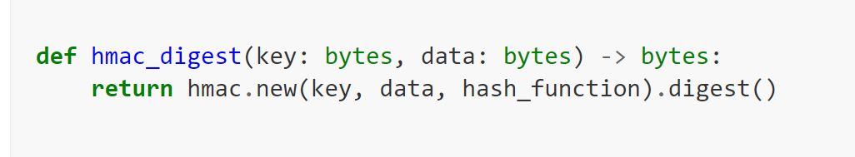

Slide 18
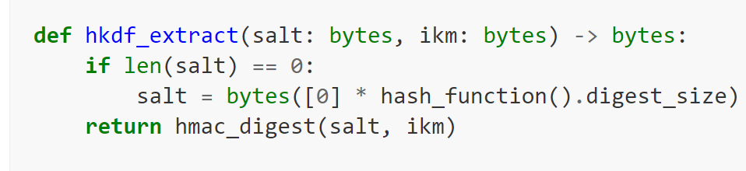

Slide 19
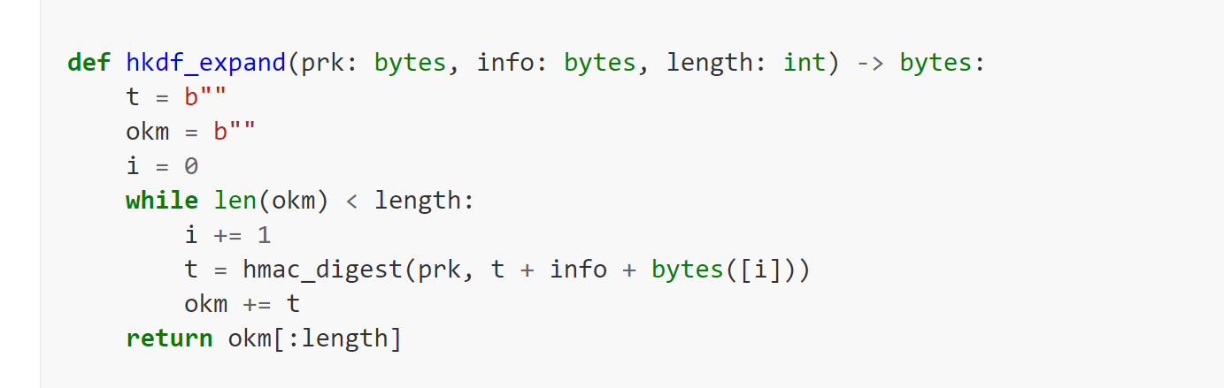

Slide 20
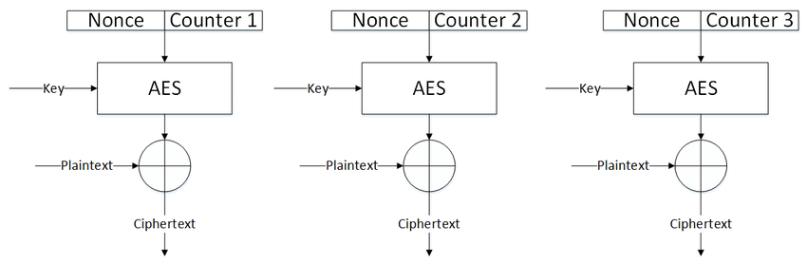

Slide 21


Slide 22
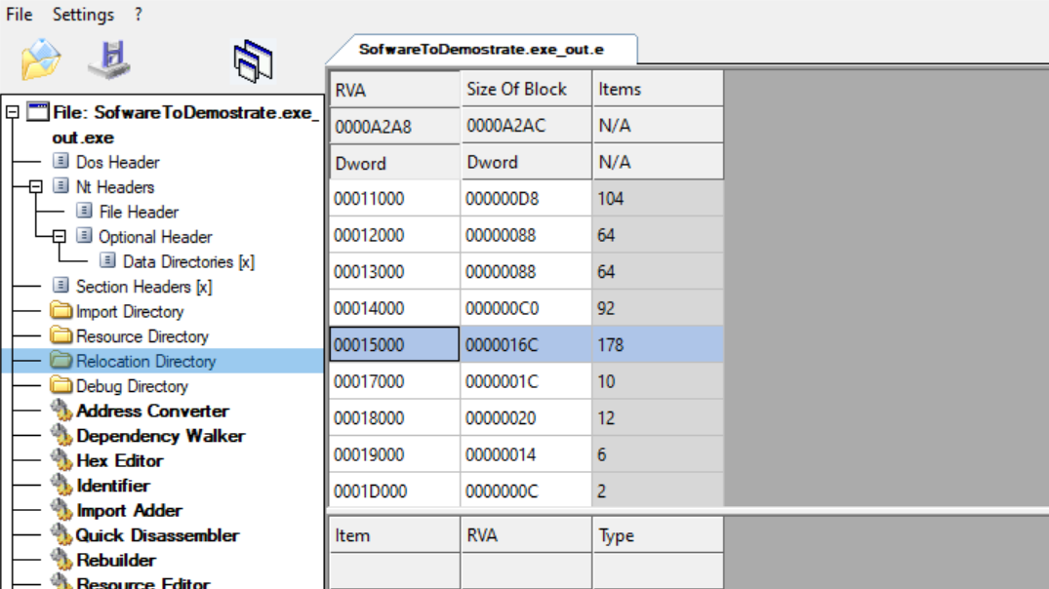

Slide 23


Slide 24

QUESTIONS ?

